Slide 1

Case Study
Virtual internship | Manal Shahab

Slide 2
Profit/distance made by Yellow Cab in every state
Profit/distance made by Pink Cab in every state
Profit
Profit
States
States
Distance(KM)
Distance(KM)
States
States

Slide 3
Note: Average profit per trip of yellow cab is greater than pink cab Total profit made (including all the states) is greater for pink cab than yellow cab Both the cabs are available in 19 states
Yellow cab
Pink cab
Profit made = ﻿$4,40,20,373.17
Number of states available in=19
﻿Average profit made per trip=﻿ $160.25
Profit made = ﻿$53,07,328.32
Number of states available in=19
Average profit made per distance KM=﻿﻿ $62.65

Slide 4
City | Population:User
NEW YORK NY | 27.8201715
CHICAGO IL | 11.8876012
LOS ANGELES CA | 11.0665015
MIAMI FL | 75.765488
SILICON VALLEY | 43.2197673
ORANGE COUNTY | 79.2815915
SAN DIEGO CA | 13.7053647
PHOENIX AZ | 153.921246
DALLAS TX | 42.5557612
ATLANTA GA | 32.9899599
DENVER CO | 60.7224056
AUSTIN TX | 46.6264521
SEATTLE WA | 26.7820293
TUCSON AZ | 110.546569

Slide 5
SAN FRANCISCO CA | 2.94739922
SACRAMENTO CA | 77.4809767
PITTSBURGH PA | 148.801812
WASHINGTON DC | 3.29807639
NASHVILLE TN | 35.2993528
BOSTON MA | 3.11128329
Note:
San Francisco has highest population is to user ratio

Slide 6
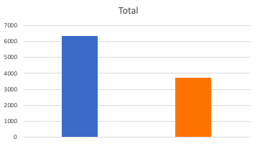
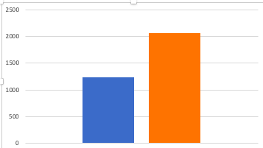
Male is to female user ratio in accordance to the ages of the users
Yellow Cab users
Pink Cab users
male
female
female
male
Male are more frequent customers among both the cabs than that of females
Yellow cab users are way more than that of the users of pink cab
Method of Payment | Yellow Cab | Pink Cab
Card | 9810 | 1923
Cash | 6577 | 1377
Users tend to pay via card
Than by cash for the cabs

Slide 7
Conclusion
Yellow cab has better performance over all
Yellow cab made more profit per trip and over all profit than that of pink cab
Yellow cab has more number of users than that of pink cab

